Slide 1

Phosphorus in the nutrition of poultry and pigs in intensive production systems
Dr David Cadogan
Feedworks

Slide 2
Scope of the presentation
Terminology of Phosphorus (P) in nutrition
  Total P, Phytate P, digestible P
Why different P sources influence growth, feed intake and health
Traps of cheap P sources
Phytate and using the Phytase enzyme to maximise P digestibility
What the Ruminant world can learn from the monogastric P nutrition

Slide 3
Phosphorus (P) essential for growth and health
Phosphorus is important for;
Bone growth
Energy source and metabolism (ATP)
Fat/lipid production
Cell membranes
Egg Production
Milk Production
Immune system

Slide 4
Marginal Phosphorus in diets causes…
Significant reduction in feed intake
Large increase in mortalities
Loss of growth
Poor bone growth and strength
Low reproductive performance
Low milk production
The digestible P requirement ranges from 0.30%-0.55% in monogastrics

Slide 5
Phosphorus availability
Only 25% of total P is available for pigs and poultry (excluding inorganic P sources)
Most P from grains/plant protein meals is “locked” away in the form of Phytate
Phosphorus availability is strongly influenced by the amount of Calcium in the diet
Ideal ratio of Calcium to Digestible/available P is 2:1 (layers 10:1)

Slide 6
Measuring Phosphorus availability in inorganic P sources
P Solubility measurements for inorganic phosphates; Citric acid, Ammonium citrate and water solubility
These are poor indicators of actual P digestibility!
There is a high relationship between ileal digestibility and total tract digestibility
Total tract P digestibility is an accurate measurement for ingredients and diets
The endogenous loss of P is consistent

Slide 7
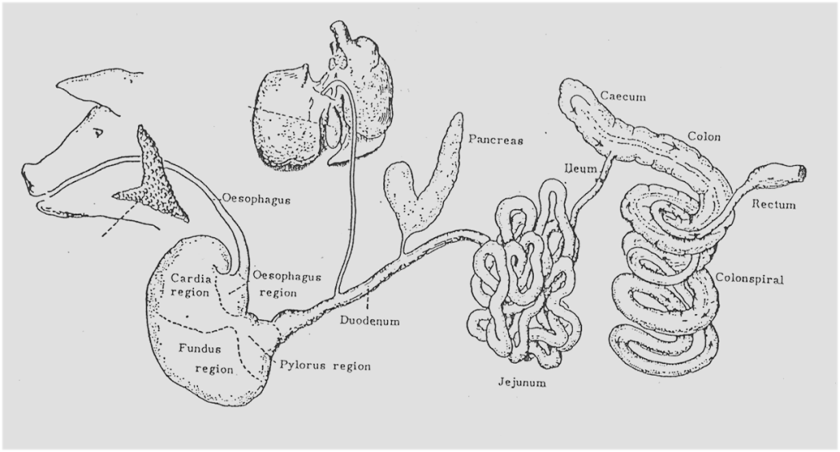
Endogenous losses
Nutrient from diet
Nutrient of endogenous origin

Slide 8
Comparison of different Phosphorus sources (INRA, Premier Atlas 2016)
Ingredient | Total P % | Amount of Digestible P %* | P Digestibility Pigs % | Citric Acid Solubility | P Solubility in water
Monosodium Phosphate | 25.5 | 23.0 | 90 | >98% | >95%
Monocalcium Phosphate | 22.7 | 20.3 | 89 | 95% | 75-95%
Mono Dicalcium Phosphate | 21.3 | 16.6 | 78 | 95% | 50-85%
Dicalcium Phosphate* | 18 | 13.1 | 72 | 90% | 10-20%
Tricalcium Phosphate* | (16)18 | 10.0 | 55 | <80% | <1%

Slide 9
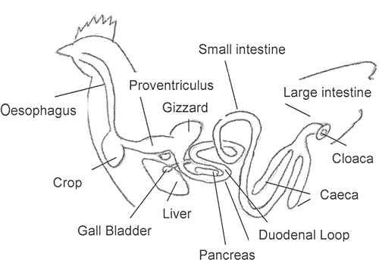
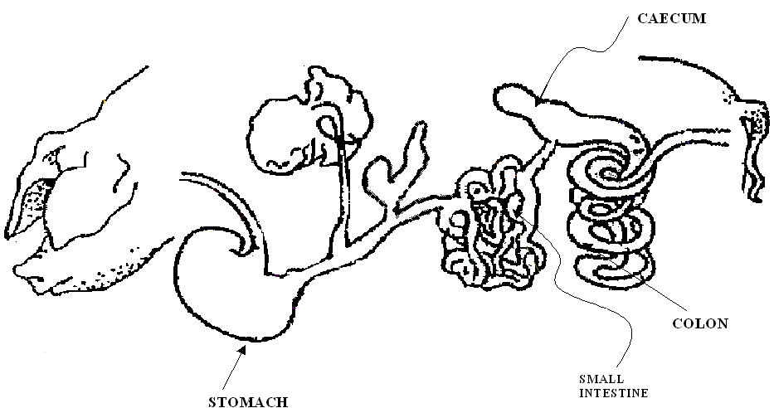
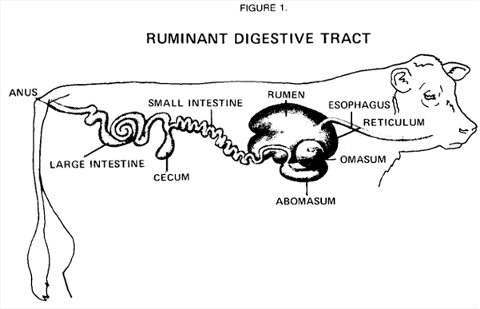
Phosphorus digestibility is similar between pigs and poultry…. Ruminants?

Slide 10
Ingredient | Total P (%) | Digestible P PIG (%) | Digestible P Poultry (%)
Monosodium Phosphate | 25.5 | 22.9 (90%) | 22.7 (89%)
Monocalcium Phosphate | 22.7 | 20.3 (89%) | 19.5 (86%)
MonoDical Phosphate | 21.3 | 16.6 (78%) | 16.8 (78%)
Dicalcium Phosphate | 18.0 | 13.1 (73%) | 14.1 (78%)
Tricalcium Phosphate | 18.0 | 10.0 (55%) | 10.0 (55%)
Meatmeal 50% | 5.00 | 4.45 (89%) | 4.45 (89%)
Wheat 12% | 0.32 | 0.11 (34%) | 0.12 (37%)
Sorghum | 0.28 | 0.08 (18%) | 0.08 (29%)
Barley 11% | 0.30 | 0.10 (33%) | 0.11 (37%)
Soybean 47% | 0.75 | 0.25 (33%) | 0.27 (36%)
Canola Meal 36% | 0.93 | 0.28 (30%) | 0.34 (37%)
Millmix/run | 1.00 | 0.30 (30%) | 0.37 (37%)
Field Peas | 0.38 | 0.17 (45%) | 0.16 (42%)
Lupins | 0.30 | 0.14 (47%) | 0.15 (50%)
Whey Powder | 0.80 | 0.65 (81%) | 0.63 (79%)
(Premier Atlas 2016)

Slide 11
Mono-calcium phosphate produces better performance than Dicalcium Phosphate
In Broilers formulated to the same available P and Calcium levels (Bikker et al, 2017)
In pigs formulated to the same digestible P and calcium (Veira et al, 2016)
In milking goats formulated to the same P and Calcium levels (Ramirez-Perez et al, 2009)

Slide 12
Change in type of inorganic Phosphorus
8-10 years ago there has been a major change in the broiler/poultry industry moving from DCP to MDCP
Now 90% using Monocalcium Phosphate due to better performance
Pig industry are gradually moving from DCP to MDCP/MCP

Slide 13

Most of the cheaper Dicalcium Phosphate is actually Tri calcium phosphate with only 55% P digestibility!!!

Slide 14
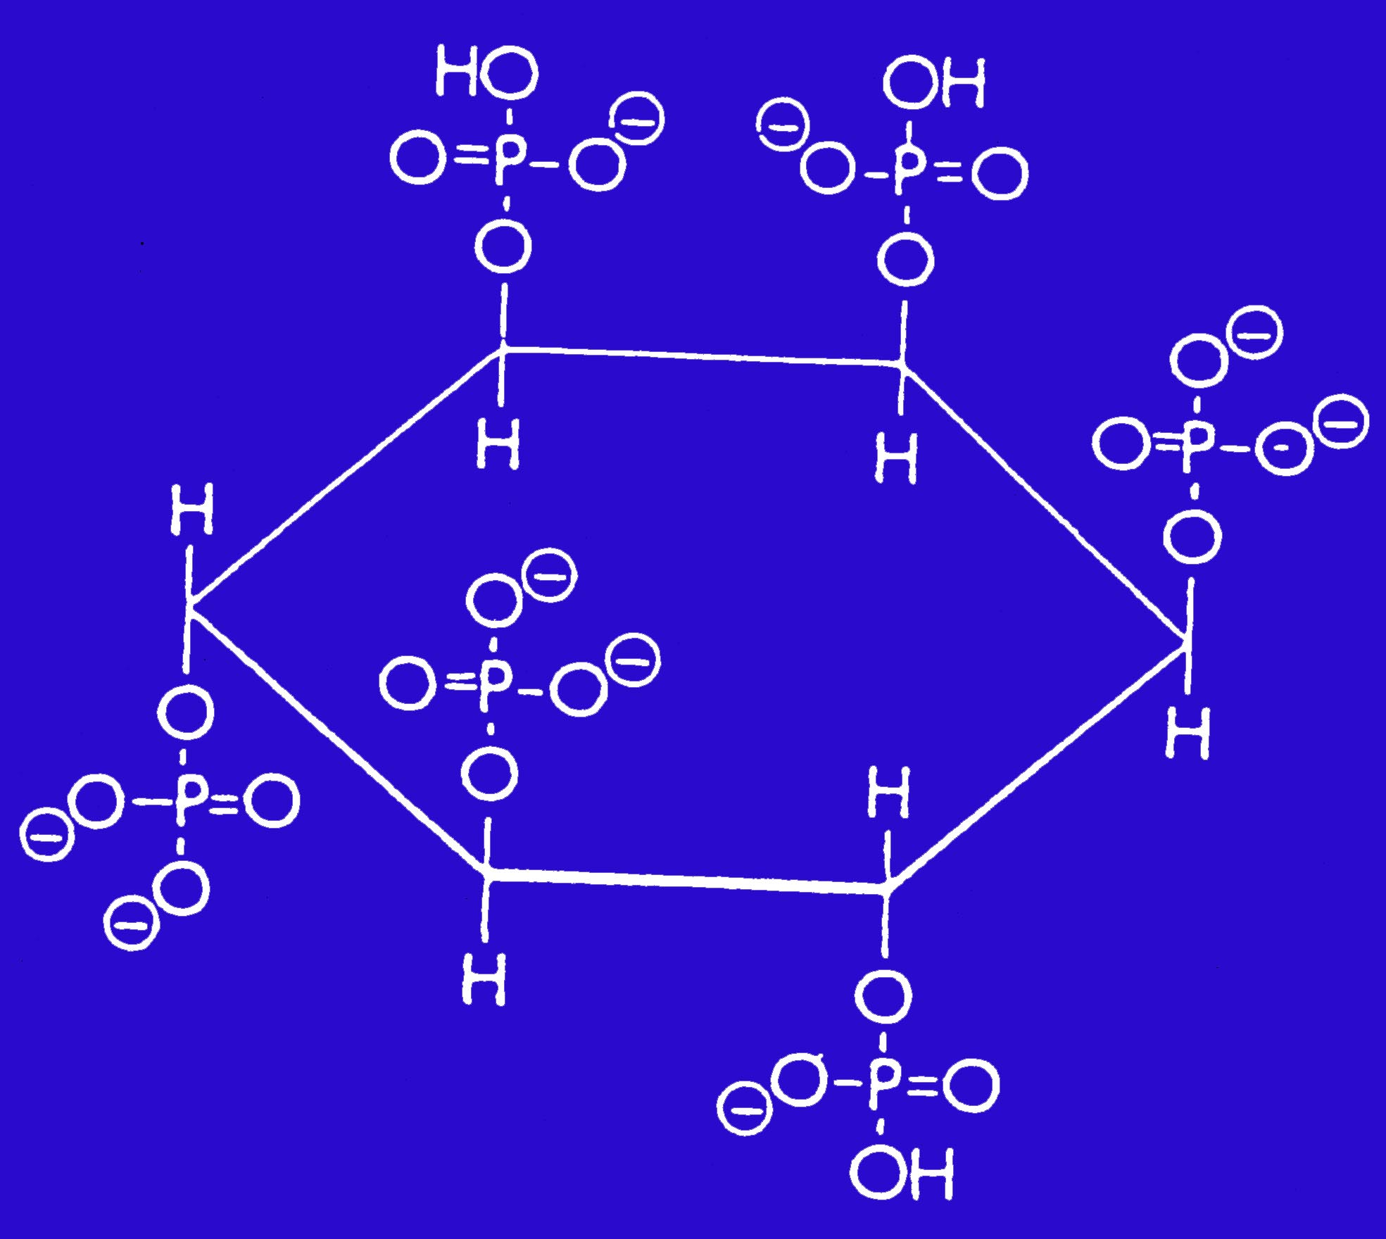
Plant Phytate
28.2% Phosphorus, mostly unavailable

Slide 16
Phytate – both a potential P source and an anti-nutrient in feed
calcium, magnesium, iron, and zinc; fatty acids; starch; proteins and amino acids
+
Ca
+
-
-
O
O
+
Ca
+
H
O
P
O
H
O
P
O
Starch
-
-
O
O
O
O
Protein
2
3
c
O
H
O
P
O
H
H
CH₂
H
O
H
O
+
-
O
H
1
Zinc
+
4
NH₃
Protein
O
P
O
+
H
O
H
O
P
-
6
5
O
O
-
Ca
O
H
O
+
+
HOCH₂
-
-
P
O
H
O
O
O
Fatty acid
C
O
O
O
O
Starch
Notes:
Phytates (phytic acid-mineral complexes), as well as providing very limited P availability to the animal in the absence of phytase, can also have other effects which can reduce nutrient digestibility and, consequently, animal performance (i.e. phytates in feed act as anti-nutrients)
At neutral or basic pH, phytic acid can form complexes with divalent and trivalent cations. These minerals and trace elements attach themselves easily onto the phosphate molecule of phytic acid producing insoluble salts. Once these compounds are produced these cations are unavailable for absorption in the gut and, like phosphorus, these valuable nutrients are then also lost to the animal.
If these insoluble salts react with fatty acids in the gut, insoluble metallic soaps are produced. It has been suggested that these soaps may lower fat digestibility and consequently may have an effect on energy availability.
Phytic acid can also form complexes with proteins and starch. These can occur in the plant (native complexes) or during digestion in the gastrointestinal tract. In the highly acidic stomach region, amino acids are bound directly to phytate phosphorus creating an insoluble complex. In the less acidic intestine, multiple bonded mineral cations act as a bridge between phytate and protein.
These complex compounds are more resistant to enzymatic digestion than their unbound counterparts.
Moreover, phytates can also potentially decrease protein and starch digestibility by inhibiting, or binding to, digestive enzymes produced by the animal (e.g. pepsin and trypsin for protein degradation and alpha-amylase for starch degradation).

Slide 17
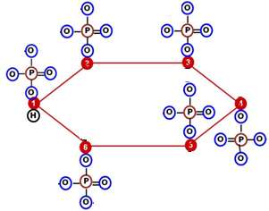
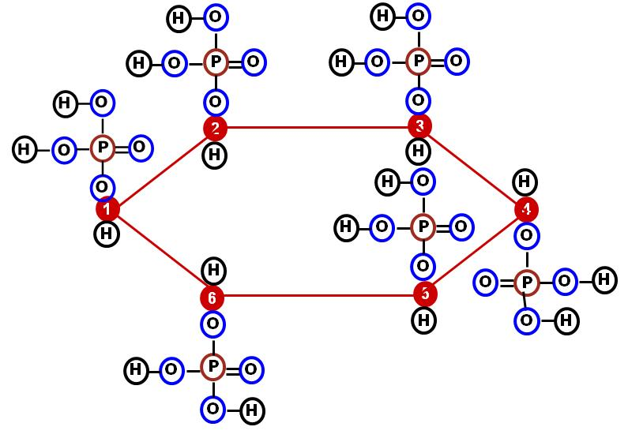

Interactions of phytic acid with dietary nutrients are pH dependent
Mineral cations also chelate at low pHs if soluble
Proteins and phytate acid also interact at higher
pHs >6 in presence of Ca²⁺
Briggs (1959, Saio et al. (1967,1968)
(Tamin et al., 2003)
Gizzard / Proventriculus
Duodenum / Ileum / Jejenum
Ca⁺⁺
Protein-Arg
Lys-protein
^{Zn++}
pH 4.0
protein
His-Protein
Ca⁺⁺
^{Mg++}
Binds with basic AA of protein
Binds w/ divalent mineral cations
pH
pH
Nelson et al., 1968; Maga, 1982; Angel et al., 2002, Selle et al.,2009,2012; Walk et al.,2012
Notes:
17

Slide 19
Phytase ↑ mineral and protein digestibility
Phosphorus digestibility by 30% to 65%
Calcium digestibility by 20-30%
      Also increases digestibility of Zinc, Copper, Iron up to 5%.
Increases protein/amino acid digestibility between 2 to 5%
Saves between $5.00 to $25.00/tonne in diet cost
95% of Australian industry monogastric industry uses Phytase

Slide 20
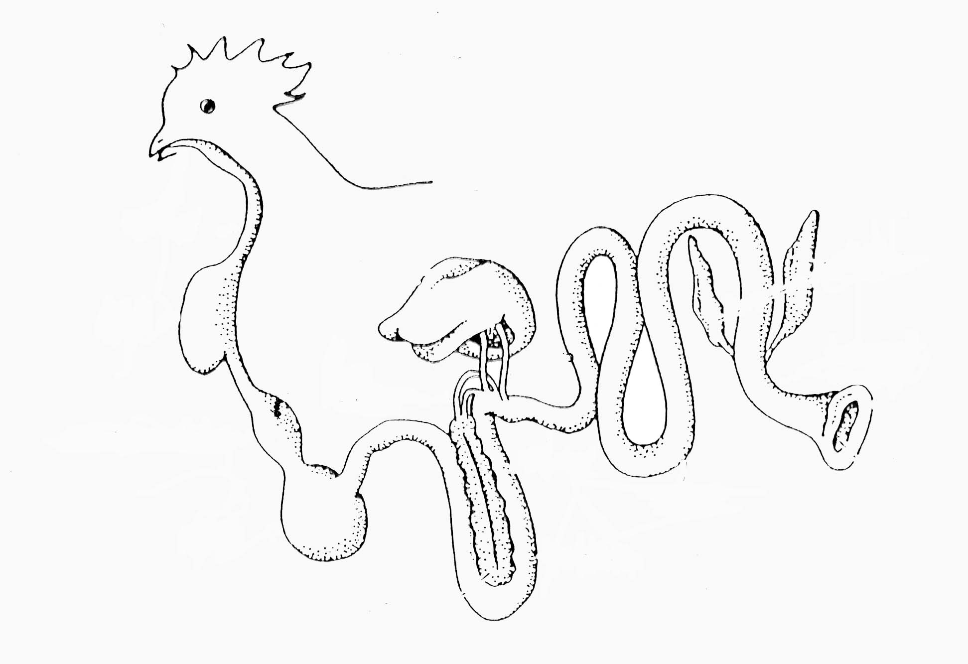

Our Objective: Hydrolyze 100% Phytate as fast as possible
Areas where exogenous phytases work most effectively
Ileum
83 m (65 – 125)
Crop
12 m
(<5 – 60 m)
Proventriculus
P+M
37 m (20 – 72)
(Slide from R. Angel, 2016)
Gizzard
Duodenum + Jejunum 91 m
(60 – 168 m)
Corn SBM diet 0.8mm GMD
Time for phytase to work @ 37 m (20 - 72)

Slide 21

Different Phytases have different pH optima and different RELATIVE activity at low pH vs. pH 5.5.
Proximal duodenum,
Gizzard+Proventriculus
Duodenum, Jejenum, Ileum
All phytases are standardized at
pH 5.5
Buttiauxella Phytase
Citrobacter Phytase
E.Coli phytase
P.lycii Phytase
DuPont Laboratory, 2012
Notes:
The activity of Axtra® PHY at different pHs was compared with the activity of 3 different commercial phytases. All commercial phytases have their activity standardised at pH 5.5. For bacterial phytases this is not the optimum activity, which occurs closer to pH 4.0. For Axtra® PHY the activity at pH 4.0 is almost double the activity at pH 5.5, indicating the phytase is highly active at this lower pH. The graph also demonstrates that at pHs less than 4.0 the Axtra® PHY has a higher activity than any of the other phytases in the test.
Citrobacter Phytase – Ronozyme HiPhos (DSM)
E.Coli Phytase – Phyzyme® XP
P.Lycii phytase – Ronozyme NP (DSM)

Slide 22
Summary
Marginal P in monogastrics reduces feed intake (and growth) and increases deaths
Higher quality ($$) inorganic P improves performance
Need to formulate on (total tract) digestibility of phosphorus, not total P!
Modern phytase at high dose rates to maximise P, Calcium,essential protein and energy digestibility
Phytase can save over $15 per tonne

